Slide 1
Text Mining Concepts and Methods: HTRC and Non-consumptive Research

Slide 2
Presented by J. Stephen Downie University of Illinois at Urbana-Champaign

Slide 3
Extra-special thanks to Jeremy York and the rest of the HathiTrust and HathiTrust Research Center teams for the use of their slides

Slide 4
Agenda
Quick Review of HathiTrust
Data Overview
Four Key Data Objects
Introducing the HathiTrust Research Center
Non-Consumptive Research
Outreach and Education
HTRC Research Projects
Exploring Impacts and Upcoming Developments
Wrap Up

Slide 5
Some Useful URLs
HathiTrust
http://hathitrust.org
HTRC Portal
https://analytics.hathitrust.org
HT + BW
https://bookworm.htrc.illinois.edu
New article from Educause Review:
http://er.educause.edu/articles/2016/5/the-hathitrust-research-center-exploring-the-full-text-frontier
Notes:
In order to guide the partnership in its initial years the founding partners articulated a set of preliminary goals:
To build a reliable and increasingly comprehensive digital archive of library materials converted from print that is co-owned and managed by a number of academic institutions.
To improve access to them in ways that, first and foremost, meet the needs of the co-owning institutions.
To preserve these materials.
To stimulate redoubled efforts to coordinate shared storage strategies among libraries, thus reducing long-term capital and operating costs of libraries associated with the storage and care of print collections.
To create and sustain this “public good” in a way that ensures greatest possible availability of materials, while offering value to members, mitigating the problem of free-riders.
To create a technical framework that is simultaneously responsive to members through the centralized creation of functionality, such as preservation services and full-text search, and sufficiently open to the creation of tools and services not created by the central organization.
I’ll be talking more about these elements, and their relation to the development of a Research Center. First I would like to describe in more detail the HathiTrust collection and the services we offer.

Slide 6
HathiTrust is...
A trusted digital preservation service enabling the broadest possible access worldwide.
An organization with over 120 research libraries making up its membership.
A distributed set of services operated by different members (California Digital Library, Illinois, Indiana, Michigan).
A range of programs enabled by the large scale collection of digitized materials.

Slide 7
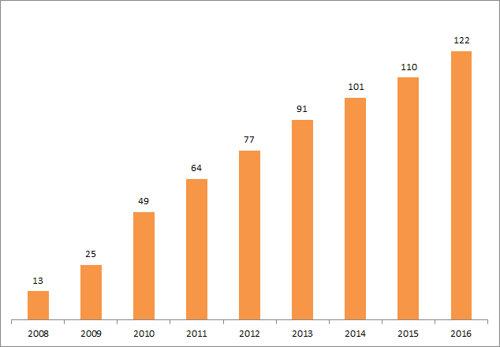
Growth in Membership
Notes:
updated 11/2/2016
CIC and UC institutions counted individually

Slide 8
Mission
Contribute to research, scholarship, and the common good by collaboratively collecting, organizing, preserving, communicating, and sharing the record of human knowledge.
…building comprehensive collections and infrastructure co-owned and managed by partners.
…infrastructure for digital content of value to scholars and researchers
…enabling access by users with print disabilities.
…supporting research with the collections.
…stimulating shared collection storage strategies among libraries.
Notes:
HathiTrust is a partnership of over 100 research libraries worldwide contributing to the common good by collecting, organizing, preserving, communicating, and sharing the record of human knowledge.
ENABLING INFRASTRUCTURE
As a partnership we strive to serve and create the public good while also enabling our libraries to provide better services and collections for their primary users.
● Build a reliable and increasingly comprehensive co-owned and managed digital archive of library materials converted from the print collections of the member institutions;
● Improve access to these materials in ways that, first and foremost, meet the needs of the member institutions;
● Help preserve these important human records by collecting reliable and accessible electronic representations;
● Enable the digital archive to be accessible to persons who have print disabilities;
● Stimulate redoubled efforts to coordinate shared storage strategies among libraries, thus reducing long-term capital and operating costs of libraries associated with the storage and care of print collections;
● Create a technical framework that is simultaneously responsive to members through the centralized creation of functionality and sufficiently open to the creation of tools and services not created by the central organization; and
● Create and sustain HathiTrust as “public good” while at the same time defining a set of services that benefits member institutions.
Way many Goals—these are recorded in the Bylaws of the Organization.
In sum, we’re working on shared strategies in a number of areas:
Comprehensive collection
Preservation…with Access
Shared strategies
Collection management, development
Copyright
Preservation (digital and print)
Bibliographic Indeterminacy
Discovery / Use
Efficient user services
Public Good

Slide 9
HathiTrust Membership 2016
Allegheny College
American University of Beirut
Amherst College
Arizona State University
Auburn University
Baylor University
Boston College
Boston University
Brandeis University
Brown University
Bryn Mawr College
Bucknell University
Carnegie Mellon University
Case Western Reserve
The Claremont Colleges
Colby College
Columbia University
Cornell University
Dartmouth College
DePaul University
Duke University
Emory University
Getty Research Institute
George Mason University
Georgetown University
Georgia Tech
Harvard University Library
Haverford College
Indiana University
Iowa State University
Johns Hopkins University
Kansas State University
Lafayette College
Library of Congress
Massachusetts Institute of Technology
McGill University
Michigan State University
Montana State University
Mount Holyoke College
New York Public Library
New York University
North Carolina Central University
North Carolina State University
Northeastern University
Northwestern University
Oklahoma State University
The Ohio State University
The Pennsylvania State University
Princeton University
Purdue University
Rutgers University
Smith College
Stanford University
State University System of Florida
Swarthmore College
Syracuse University
Temple University
Texas A&M University
Texas Tech University
Tufts University
Tulane University
Universidad Complutense de Madrid
University of Alabama
University of Alberta
University of Arizona
University of British Columbia
University of Calgary
University of California
Berkeley
Davis
Irvine
Los Angeles
Merced
Riverside
San Diego
San Francisco
Santa Barbara
Santa Cruz
California Digital Library
The University of Chicago
University of Connecticut
University of Delaware
University of Houston
University of Illinois
University of Illinois at
Chicago
The University of Iowa
University of Kansas
University of Maine
University of Maryland
University of Massa-
chusetts, Amherst
University of Miami
University of Michigan
University of Minnesota
University of Missouri
University of Nebraska-Lincoln
University of Nevada-Las Vegas
University of New Mexico
The University of North Carolina at Chapel Hill
University of Notre Dame
University of Oklahoma
University of Pennsylvania
University of Pittsburgh
University of Queensland
University of Rochester
University of Tennessee, Knoxville
University of Texas
University of Utah
University of Vermont
University of Virginia
University of Washington
University of Wisconsin-
Madison
University of Wyoming
Utah State University
Vanderbilt University
Virginia Tech
Wake Forest University
Washington University
Washington State
University
Wesleyan University
West Virginia University
Williams College
Yale University Library
Notes:
106 members as of JUL 2015
4 in Canada
1 in Australia
1 in Beirut
1 in Spain

Slide 10
HathiTrust Membership 2016
Allegheny College
American University of Beirut
Amherst College
Arizona State University
Auburn University
Baylor University
Boston College
Boston University
Brandeis University
Brown University
Bryn Mawr College
Bucknell University
Carnegie Mellon University
Case Western Reserve
The Claremont Colleges
Colby College
Columbia University
Cornell University
Dartmouth College
DePaul University
Duke University
Emory University
Getty Research Institute
George Mason University
Georgetown University
Georgia Tech
Harvard University Library
Haverford College
Indiana University
Iowa State University
Johns Hopkins University
Kansas State University
Lafayette College
Library of Congress
Massachusetts Institute of Technology
McGill University
Michigan State University
Montana State University
Mount Holyoke College
New York Public Library
New York University
North Carolina Central University
North Carolina State University
Northeastern University
Northwestern University
Oklahoma State University
The Ohio State University
The Pennsylvania State University
Princeton University
Purdue University
Rutgers University
Smith College
Stanford University
State University System of Florida
Swarthmore College
Syracuse University
Temple University
Texas A&M University
Texas Tech University
Tufts University
Tulane University
Universidad Complutense de Madrid
University of Alabama
University of Alberta
University of Arizona
University of British Columbia
University of Calgary
University of California
Berkeley
Davis
Irvine
Los Angeles
Merced
Riverside
San Diego
San Francisco
Santa Barbara
Santa Cruz
California Digital Library
The University of Chicago
University of Connecticut
University of Delaware
University of Houston
University of Illinois
University of Illinois at
Chicago
The University of Iowa
University of Kansas
University of Maine
University of Maryland
University of Massa-
chusetts, Amherst
University of Miami
University of Michigan
University of Minnesota
University of Missouri
University of Nebraska-Lincoln
University of Nevada-Las Vegas
University of New Mexico
The University of North Carolina at Chapel Hill
University of Notre Dame
University of Oklahoma
University of Pennsylvania
University of Pittsburgh
University of Queensland
University of Rochester
University of Tennessee, Knoxville
University of Texas
University of Utah
University of Vermont
University of Virginia
University of Washington
University of Wisconsin-
Madison
University of Wyoming
Utah State University
Vanderbilt University
Virginia Tech
Wake Forest University
Washington University
Washington State
University
Wesleyan University
West Virginia University
Williams College
Yale University Library
Notes:
106 members as of JUL 2015
4 in Canada
1 in Australia
1 in Beirut
1 in Spain

Slide 11
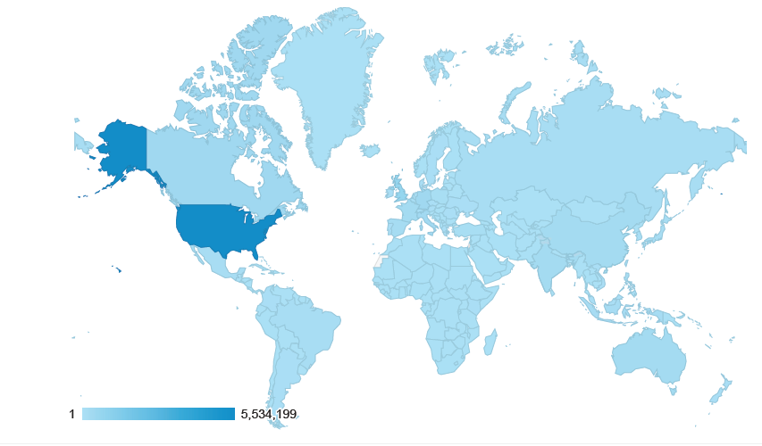
Locations of Users, Last 12 months
We have users from everywhere!
Notes:
updated 11/3/2016

Slide 12
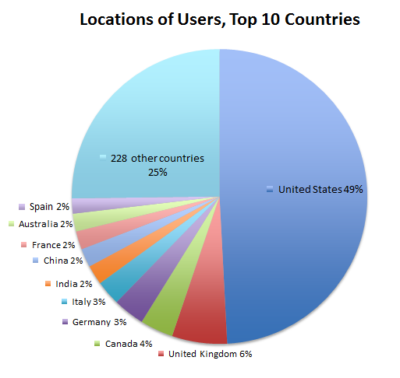
Notes:
updated 11/3/2016

Slide 13
HathiTrust “Wow” Numbers
14,781,191 total volumes
7,368,624 book titles
406,445 serial titles
5,173,416,850 pages
663 terabytes
175 miles
12,010 tons
5,708,348 volumes(~39% of total) in the public domain (November 2016)

Slide 14
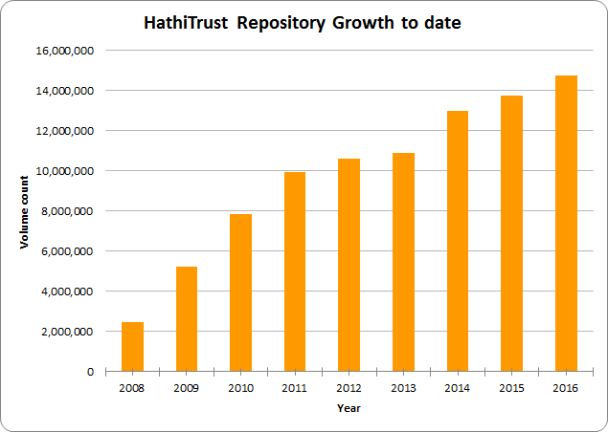
Notes:
updated 11/2/2016

Slide 15
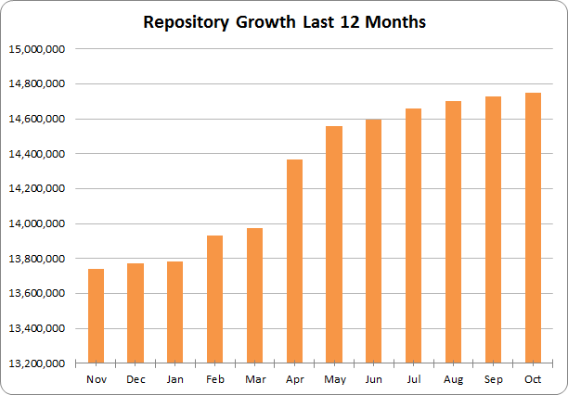
Notes:
updated 11/2/2016

Slide 16
Contributing Institutions: Top 10
Contributor | Volumes | Percentage of Collection
University of Michigan | 4,714,232 | 32%
University of California | 3,835,602 | 26%
Harvard University | 841,969 | 6%
Cornell University | 585,261 | 4%
University of Wisconsin - Madison | 561,945 | 4%
Indiana University | 530,763 | 4%
University of Illinois at Urbana-Champaign | 528,560 | 4%
University of Minnesota | 503,058 | 3%
The University of Texas | 460,139 | 3%
Pennsylvania State University | 390,345 | 3%
Remaining 42 Contributors | 1,797,101 | 12%
Notes:
updated 11/2/2016

Slide 17
Data Overview
Notes:
I’d like to spend some time now putting or locating HathiTrust and the HathiTrust Research Center in the broader context of textual analysis in general over the years to get a sort of thousand-foot view of what it is that we are now accomplishing.
Numerous projects were begun in the 1990s and early 2000s, including digitization of printed volumes on a larger scale (for instance in the Making of American project at the University of Michigan and Cornell). These projects and the resources they made available were the beginnings of, or gave rise to Digital Humanities – humanities study that leveraged or were influenced by the digitization of materials.
The early days of digitization, in the 1990s in particular, were about developing standards for digitization, experimenting with work at scale, but nothing comprehensive was undertaken except with respect to digitizing perhaps an entire collection of papers or a small set of resources.
As digitization and digital humanities projects have progressed, there have been efforts to link initiatives together to provide a research corpus that is more comprehensive. The NINES project, which offers federated search of digital resources including targeted websites such as the Willa Cather Archive and British Women Romantic Poets, is an example, and there are others.
Enter large-scale digitization and HathiTrust
New possibilities for computational research were introduced with initiatives to engage in digitization on a large-scale. From the beginning, these possibilities were seen by HathiTrust-participating institutions and one of earliest multi-institution HathiTrust working groups formed was to consider the development of a HathiTrust Research Center.
At the time, discussions centered largely around the Google Settlement and included discussions of the infrastructure and policies that would need to be in place to enable “non-consumptive” research. The effort to establish a research center was always larger than Google, however, as there were more materials in HathiTrust than were digitized by Google alone, and an awareness that there would be more over time. The vision for a research center indeed was as broad as the vision for HathiTrust – to enable new kinds of discovery, new kinds of research across an increasingly comprehensive body of materials, with our progress in these areas determined by our needs for research, and our ability to put forward the resources to meet those needs.
The HathiTrust Research Center is a fantastic example of the collective action that HathiTrust was formed to catalyze. Experts from across the partnership assembled over a period of several months in the initial working group to discuss types of research, infrastructure, and legal dimensions of a research center.
The University of Illinois and Indiana University jointly submitted and RFP to develop the HathiTrust Research Center. The Research Center initiative was seen to be so valuable by these institutions that Indiana and Illinois directed their own institutional resources to create the infrastructure and leadership that were needed to launch it. It added that much more to the effort that the leadership was formed from faculty of these institutions, as opposed to the libraries in support of faculty. In its first phase of development the HTRC has already attracted funding from Sloan to investigate issues of computation across in-copyright materials, and we can expect the Research Center to be a magnet for other funding in the future.
The HTRC is a terrific example of what we can accomplish by working together to address common needs and challenges. In HathiTrust in general we have seen an initiative to aggregate the results of past and ongoing digitization and digital production into a collective collection. The Research Center represents a venture similarly to bring together research initiatives of our institutions; solving common problems in research by bringing researchers to the corpus - to the data - facilitating not only more comprehensive research, but addressing at the same time challenges of formats, standards, and curation, and reuse in a unified environment.

Slide 18
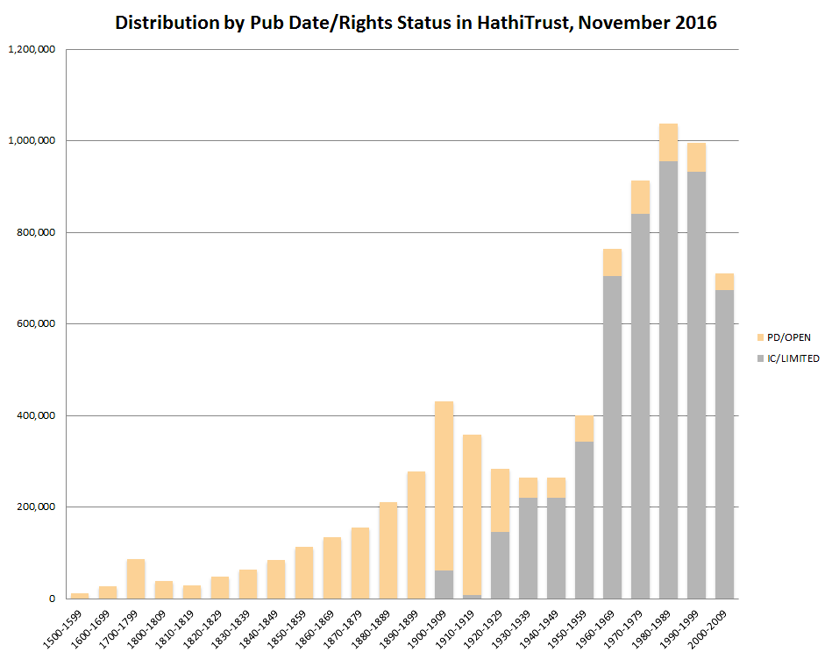

Slide 19
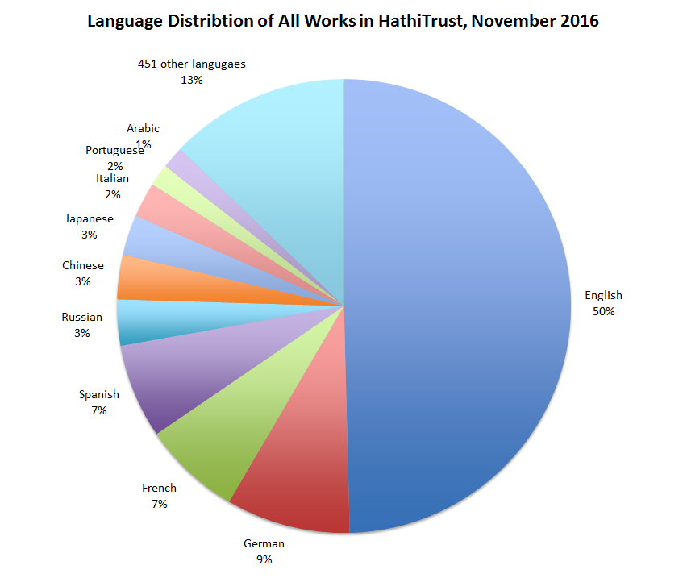
The top 10 languages make up ~87% of all content

Slide 20
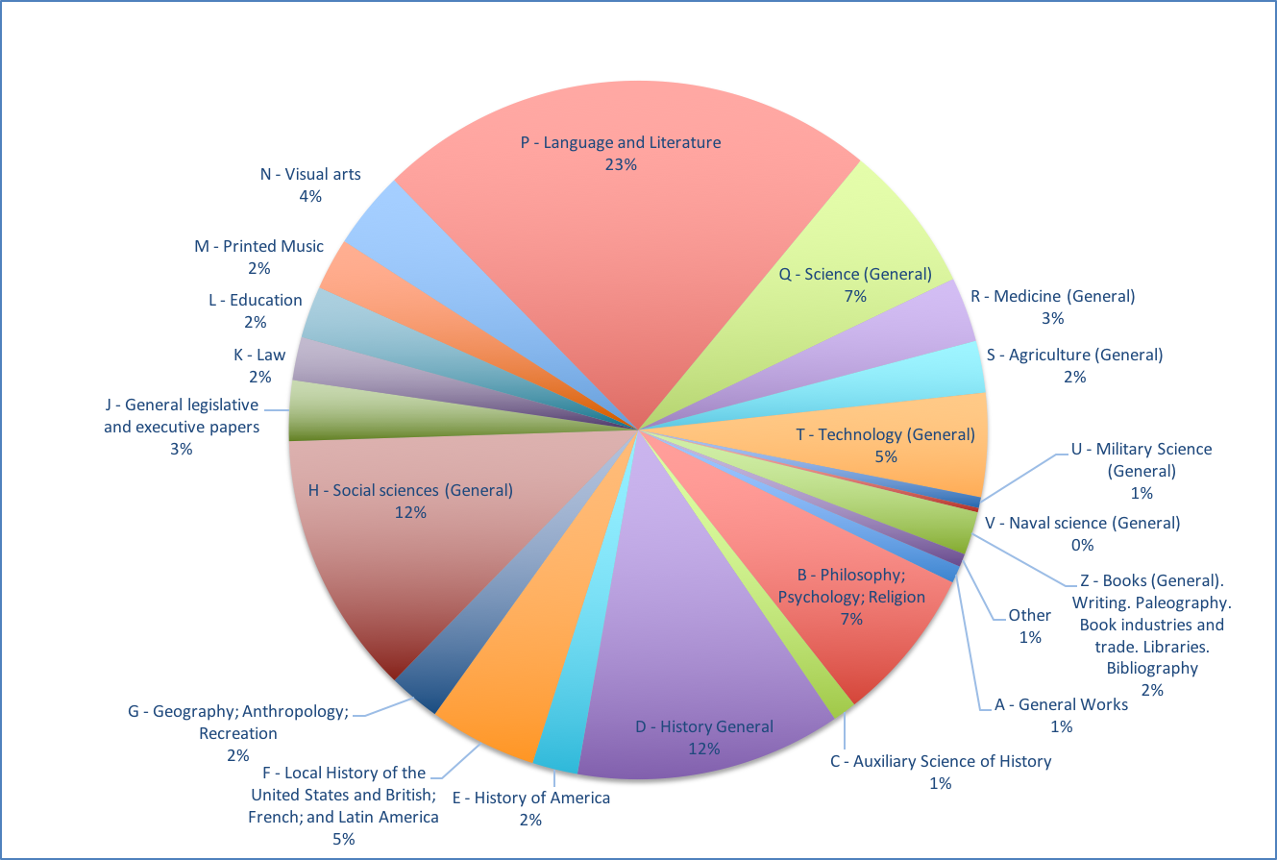
Call Number Distribution

Slide 21
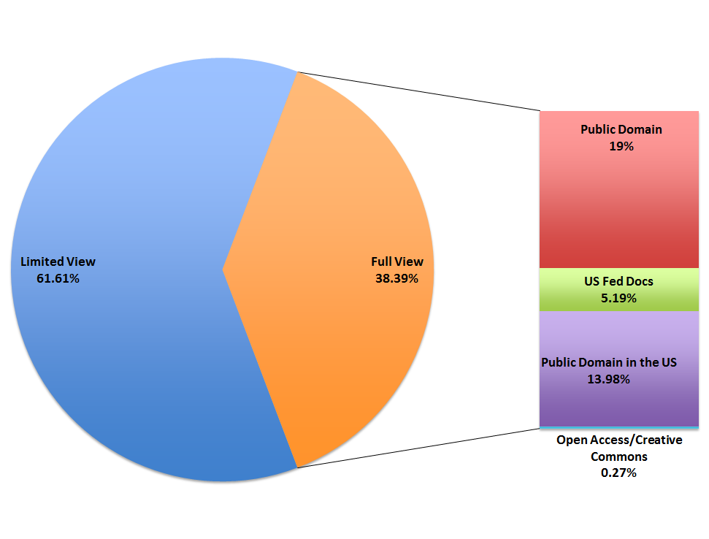
HathiTrust Titles by Copyright/View Status
Notes:
Updated 11/4/2016

Slide 22
Four Key Data Objects
Notes:
I’d like to spend some time now putting or locating HathiTrust and the HathiTrust Research Center in the broader context of textual analysis in general over the years to get a sort of thousand-foot view of what it is that we are now accomplishing.
Numerous projects were begun in the 1990s and early 2000s, including digitization of printed volumes on a larger scale (for instance in the Making of American project at the University of Michigan and Cornell). These projects and the resources they made available were the beginnings of, or gave rise to Digital Humanities – humanities study that leveraged or were influenced by the digitization of materials.
The early days of digitization, in the 1990s in particular, were about developing standards for digitization, experimenting with work at scale, but nothing comprehensive was undertaken except with respect to digitizing perhaps an entire collection of papers or a small set of resources.
As digitization and digital humanities projects have progressed, there have been efforts to link initiatives together to provide a research corpus that is more comprehensive. The NINES project, which offers federated search of digital resources including targeted websites such as the Willa Cather Archive and British Women Romantic Poets, is an example, and there are others.
Enter large-scale digitization and HathiTrust
New possibilities for computational research were introduced with initiatives to engage in digitization on a large-scale. From the beginning, these possibilities were seen by HathiTrust-participating institutions and one of earliest multi-institution HathiTrust working groups formed was to consider the development of a HathiTrust Research Center.
At the time, discussions centered largely around the Google Settlement and included discussions of the infrastructure and policies that would need to be in place to enable “non-consumptive” research. The effort to establish a research center was always larger than Google, however, as there were more materials in HathiTrust than were digitized by Google alone, and an awareness that there would be more over time. The vision for a research center indeed was as broad as the vision for HathiTrust – to enable new kinds of discovery, new kinds of research across an increasingly comprehensive body of materials, with our progress in these areas determined by our needs for research, and our ability to put forward the resources to meet those needs.
The HathiTrust Research Center is a fantastic example of the collective action that HathiTrust was formed to catalyze. Experts from across the partnership assembled over a period of several months in the initial working group to discuss types of research, infrastructure, and legal dimensions of a research center.
The University of Illinois and Indiana University jointly submitted and RFP to develop the HathiTrust Research Center. The Research Center initiative was seen to be so valuable by these institutions that Indiana and Illinois directed their own institutional resources to create the infrastructure and leadership that were needed to launch it. It added that much more to the effort that the leadership was formed from faculty of these institutions, as opposed to the libraries in support of faculty. In its first phase of development the HTRC has already attracted funding from Sloan to investigate issues of computation across in-copyright materials, and we can expect the Research Center to be a magnet for other funding in the future.
The HTRC is a terrific example of what we can accomplish by working together to address common needs and challenges. In HathiTrust in general we have seen an initiative to aggregate the results of past and ongoing digitization and digital production into a collective collection. The Research Center represents a venture similarly to bring together research initiatives of our institutions; solving common problems in research by bringing researchers to the corpus - to the data - facilitating not only more comprehensive research, but addressing at the same time challenges of formats, standards, and curation, and reuse in a unified environment.

Slide 23
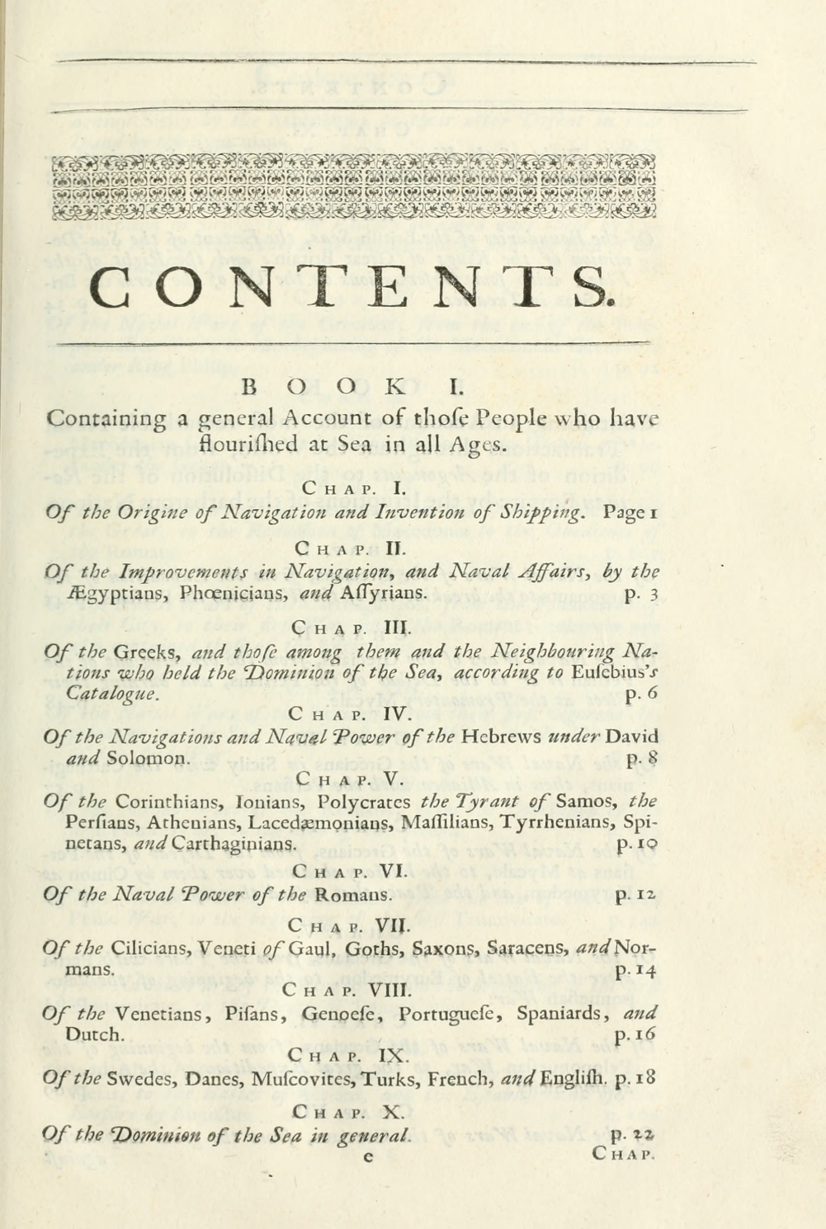

Slide 24
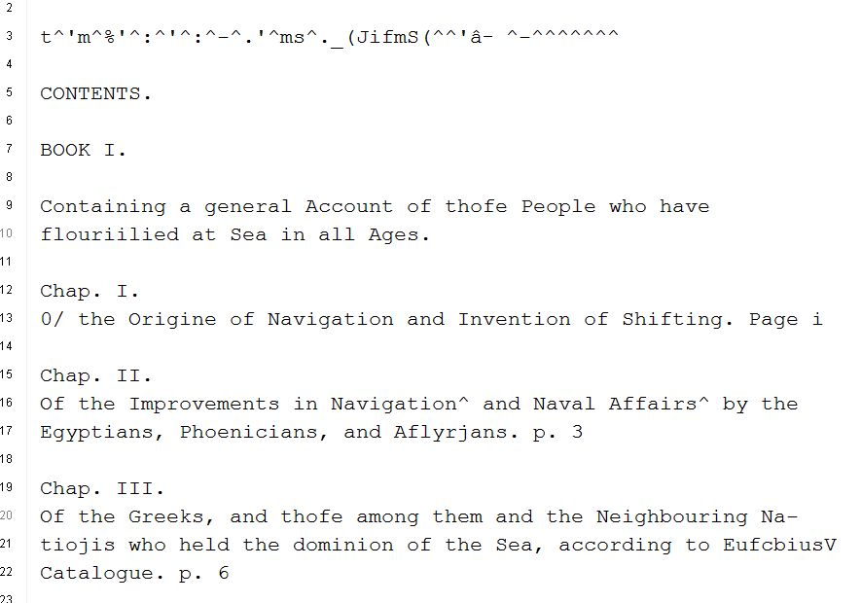

Slide 26
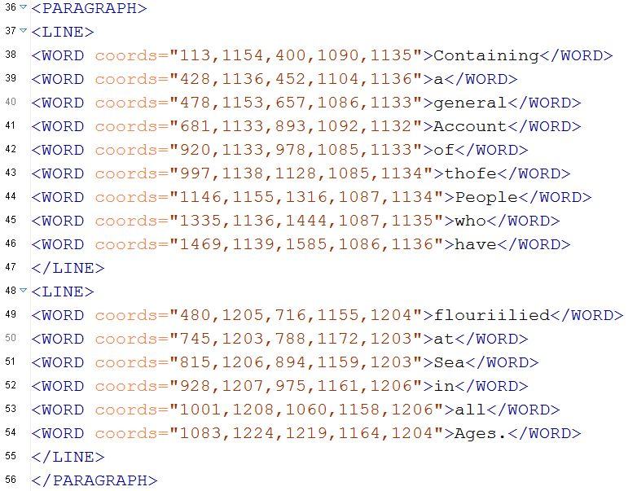

Slide 27
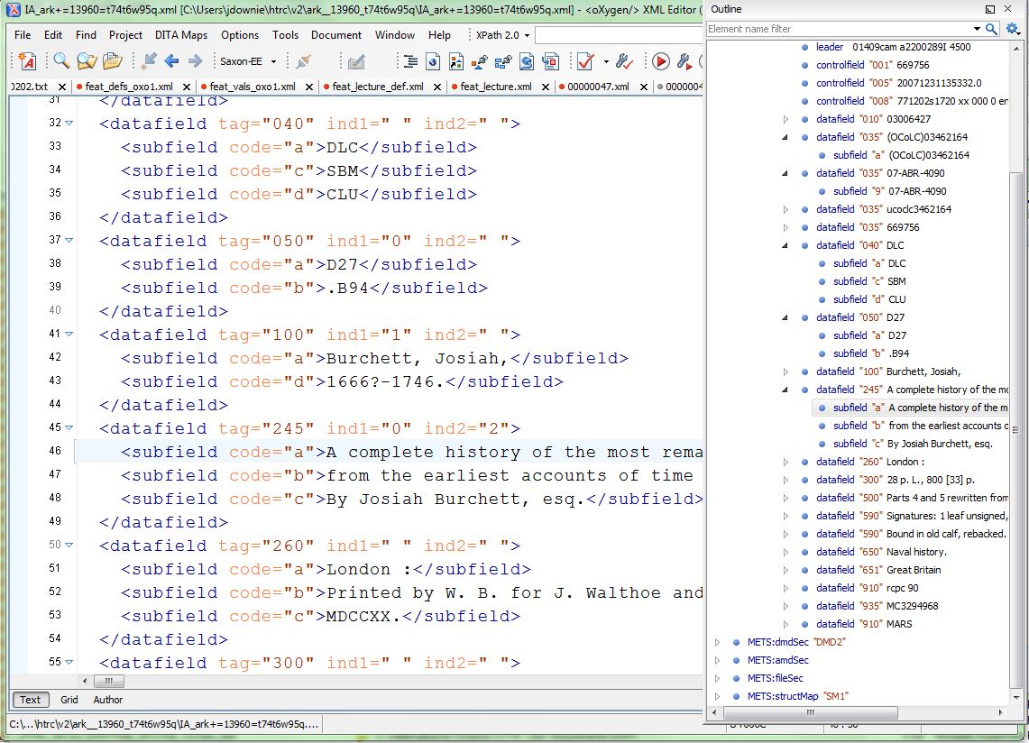

Slide 28
Datasets
Distribution of datasets
http://www.hathitrust.org/datasets
Non-Google-digitized Dataset (540,000+)
PD, PDUS, Open Access
Signed researcher statement
Google-digitized (5.4 million+)
PD, PDUS, Open Access
Agreement between institution and Google
Brief proposal
Characterize texts
Provide ids (custom sets possible)
Research, results, use of results
Signed researcher statement (institutional)

Slide 29
Introducing the HathiTrust Research Center

Slide 30

Mission of the HT Research Center
Research arm of HathiTrust
Established: July, 2011
Collaborative center: Indiana University & University of Illinois
Mission: Enable researchers world-wide to accomplish tera-scale text data-mining and analysis
Develop cyberinfrastructure to enable HPC access to the HathiTrust Digital Library
Develop cutting-edge software tools for processing, analyzing text
Develop translational tools and data that can be used to enhance HathiTrust Digital Library services to users

Slide 31

HTRC Governance
Reports to the HathiTrust Board of Governors
HTRC Executive Committee
J. Stephen Downie (Co-director), Professor and Associate Dean for Research, University of Illinois GSLIS
Beth Plale (Co-director and Chair), Director Data To Insight Center and professor in the School of Informatics and Computing at Indiana University
Robert H. McDonald, Associate Dean of Libraries/Deputy Director Data to Insight Center at Indiana University
Beth Sandore Namachchivaya, Associate University Librarian for Information Technology Planning & Policy at the University of Illinois
John Unsworth, Vice Provost for Library & Technology Services and Chief Information Officer at Brandeis University

Slide 32
Board of Governors
Executive Committee
Executive Director
HathiTrust
University of Michigan
HathiTrust Research Center
Data Copy #1
Data Copy #2
Indiana University
University of Illinois
Notes:
This last broadened HathiTrust governance to a 12-member Board of Governors, composed of 6 members elected from the partnership and 6 appointed by the founding members. The Board was charged with conducting financial oversight of the partnership, developing strategies, setting priorities, and creating working groups and committees to carry out the work of the partnering institutions.
The Constitutional Convention, the establishment of broader, shared governance, and the precedent of collective decision-making about future initiatives and ways of conducting business - were truly significant developments and events in the history of our partnership. We believe in the expertise of our colleagues and the power of what we can do collectively to achieve common goals. We believe that the deeper our collaborative ties – with libraries, with students, faculty – the more we can do to advance our knowledge and scholarship, and ensure that these are carried forward to future generations.

Slide 33
Goals for HTRC
Provide a persistent and sustainable structure to enable original and cutting edge research.
Leverage data storage and computational infrastructure at Indiana & Illinois
Stimulate community development of new functionality and tools
Use tools to enable discoveries that would not be possible without the HTRC
Enable scholars to fully utilize content of HathiTrust Library while preventing intellectual property misuse within U.S. copyright law.
Provision secure computational and data environment for scholars to perform research using HathiTrust Digital Library.

Slide 34
HTRC 2014-2018 Org Chart
HTRC Executive Mgmt
Administrative Support
Advanced Research
Advanced Collaborative Support
Scholarly Commons
Core Development

Slide 35
Non-Consumptive Research Model

Slide 36
Type of work | Searchable (bibliographic and full-text) | Viewable* | Full-PDF download (Data API) | Print on Demand | Print disabilities* | Preservation uses (Section 108)*
Public domain worldwide | Worldwide | Worldwide | Partners only if scanned by Google, if not, worldwide. | Worldwide | Partners worldwide | N/A
Public domain (US) – Non-US works published between 1872 and 1923. | Worldwide | When accessed from with the United States | Partners in the US if scanned by Google, if not, anyone US | Available within the United States | Partners in the US; partners worldwide where similar laws in effect | N/A
Works that rights holders have opened access to in HathiTrust | Worldwide | Worldwide | Worldwide (if digitized by Google, full-PDF only available if opened with CC license) | Worldwide with permission | Partners worldwide | N/A
Works that are in-copyright or of undetermined status | Worldwide | Not available | Not available | Not available | Partners in the US; partners worldwide where similar laws in effect | Partners in the US; partner worldwide where similar laws in effect
Orphan works | Worldwide | To participating partners | Not available | Not available | Partners in the US | Partners in the US; partners worldwide where similar laws in effect
* Note: Access to in-copyright works is subject to conditions on Terms of Access slide. See here also.

Slide 37
Lawful uses of in-copyright works
Full-text search
Access to users who have print disabilities
Access works that are damaged or missing and also out of print
Subject to terms and conditions at http://www.hathitrust.org/access_use#ic-access
Non-consumptive analytic research

Slide 38
Non-Consumptive Research
From the rejected Google Book Settlement:
“Non-Consumptive Research’ means research in which computational analysis is performed on one or more Books, but not research in which a researcher reads or displays substantial portions of a Book to understand the intellectual content presented within the Book.”
(a) Image Analysis and Text Extraction
(b) Textual Analysis and Information Extraction
(c) Linguistic Analysis
(d) Automated Translation
(e) Indexing and Search
Notes:
The term "Non-Consumptive Research" was invented as part of The Google Books Settlement Agreement (of 2008, a settlement later rejected by the circuit court judge to whom it was presented (rejected on the ground that it arrogated to itself the US congress's exclusive power to make copyright law). In the Definitions section of that Agreement, here's how the term is defined:

Slide 39
Non-Consumptive Research Paradigm
Bring the
COMPUTATION
to the
DATA!

Slide 40
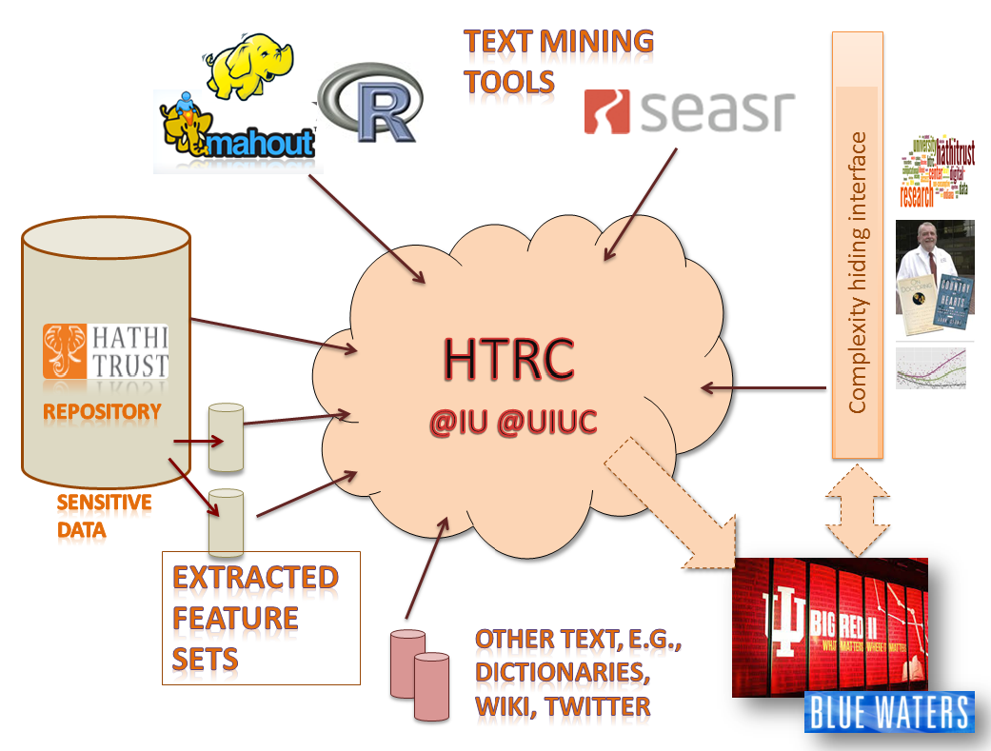
HTRC Overview

Slide 41
Four Important Approaches
Secure Portal Access
Data Capsule Access
Feature Extraction Services
Outreach and Education

Slide 42

HTRC Architecture
Portal Access
Blacklight
Direct programmatic access (by programs running on HTRC machines)
Agent
Job Submission
Collection building
Security (OAuth2)
Data API access interface
Solr Proxy
Registry (WSO2)
Audit
Algorithms
Meandre Workflows
Cassandra cluster volume store
Result Sets
Collections
Solr index
Compute resources
Storage resources
Notes:
Registry – agent can deploy any service listed in this digram and can run with the computational resources –
Original Plan iis to use XSEDE – not using this on IIS machine but are using ODIN (128 node cluster each core has 4Gb memory and 4 computation cores)– smoketree (D2I server)(24 cores physical 48 loical cores 128 GB memory) – these are not long term just using for now -

Slide 43
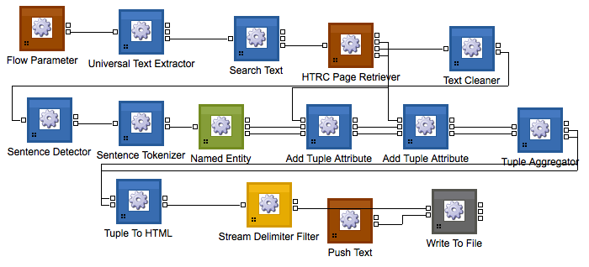

HTRC Architecture
Portal Access
Portal Access
HTRC Portal
Blacklight
Direct programmatic access (by programs running on HTRC machines)
Agent
Blacklight
Job Submission
Collection building
Security (OAuth2)
App SEAR
App Blacklight
Data API access interface
Solr Proxy
Registry (WSO2)
Audit
Algorithms
Meandre Workflows
Cassandra cluster volume store
Result Sets
Collections
Solr index
Compute resources
Storage resources
Notes:
Registry – agent can deploy any service listed in this digram and can run with the computational resources –
Original Plan iis to use XSEDE – not using this on IIS machine but are using ODIN (128 node cluster each core has 4Gb memory and 4 computation cores)– smoketree (D2I server)(24 cores physical 48 loical cores 128 GB memory) – these are not long term just using for now -

Slide 44
HTRC Architecture
Agent
Portal Access
HTRC Agent
Blacklight
Direct programmatic access (by programs running on HTRC machines)
Job
Submission
Collection building
Agent
Job Submission
Collection building
Security (OAuth2)
Data API access interface
Solr Proxy
Registry (WSO2)
Audit
Algorithms
Meandre Workflows
Cassandra cluster volume store
Result Sets
Collections
Solr index
Compute resources
Storage resources
Notes:
Registry – agent can deploy any service listed in this diagram and can run with the computational resources –
Original Plan iis to use XSEDE – not using this on IIS machine but are using ODIN (128 node cluster each core has 4Gb memory and 4 computation cores)– smoketree (D2I server)(24 cores physical 48 loical cores 128 GB memory) – these are not long term just using for now -

Slide 45

HTRC Architecture
1
HTRC Registry
Portal Access
Registry (WSO2)
Blacklight
Algorithms
Meandre Workflows
Direct programmatic access (by programs running on HTRC machines)
Agent
Job Submission
Collection building
Result Sets
Collections
Security (OAuth2)
Data API access interface
Solr Proxy
Registry (WSO2)
Audit
Algorithms
Meandre Workflows
Cassandra cluster volume store
Result Sets
Collections
Solr index
Compute resources
Storage resources
Notes:
Registry – agent can deploy any service listed in this diagram and can run with the computational resources –
Original Plan iis to use XSEDE – not using this on IIS machine but are using ODIN (128 node cluster each core has 4Gb memory and 4 computation cores)– smoketree (D2I server)(24 cores physical 48 loical cores 128 GB memory) – these are not long term just using for now -

Slide 46

HTRC Architecture
Secure Data API
Portal Access
Blacklight
RESTful Web Service
Language agnostic
Clients don’t have to deal with Cassandra
Simple OAuth2 authentication
HTTP over SSL
Audits client access
Protected behind firewall, accessible only to authorized IPs
Direct programmatic access (by programs running on HTRC machines)
Agent
Job Submission
Collection building
Security (OAuth2)
Data API access interface
Solr Proxy
Registry (WSO2)
Audit
Algorithms
Meandre Workflows
Cassandra cluster volume store
Result Sets
Collections
Solr index
HTRC
Compute resources
Storage resources
Notes:
Registry – agent can deploy any service listed in this digram and can run with the computational resources –
Original Plan iis to use XSEDE – not using this on IIS machine but are using ODIN (128 node cluster each core has 4Gb memory and 4 computation cores)– smoketree (D2I server)(24 cores physical 48 loical cores 128 GB memory) – these are not long term just using for now -

Slide 47
HTRC Architecture
Solr Proxy
Portal Access
Blacklight
Direct programmatic access (by programs running on HTRC machines)
Agent
Solr proxy
Job Submission
Collection building
Security (OAuth2)
Solr service
Data API access interface
Solr Proxy
Registry (WSO2)
Audit
Algorithms
Meandre Workflows
Cassandra cluster volume store
Result Sets
Collections
Solr index
RFS distributed file system
Compute resources
Storage resources
Notes:
Registry – agent can deploy any service listed in this digram and can run with the computational resources –
Original Plan iis to use XSEDE – not using this on IIS machine but are using ODIN (128 node cluster each core has 4Gb memory and 4 computation cores)– smoketree (D2I server)(24 cores physical 48 loical cores 128 GB memory) – these are not long term just using for now -

Slide 48





Data Capsule Team
HTRC Data Capsule@IU Team
Beth Plale (PI)
Jiaan Zeng
Guangchen Ruan
HTRC Data Capsule@Michigan Team
Atul Prakash (PI)
Alexander Crowell
Jiaan Zeng, Guangchen Ruan, Alexander Crowell, Atul Prakash, and Beth Plale. 2014. Cloud computing data capsules for non-consumptiveuse of texts. In Proceedings of the 5th ACM workshop on Scientific cloud computing (ScienceCloud '14). ACM, New York, NY, USA, 9-16. DOI=10.1145/2608029.2608031 http://doi.acm.org/10.1145/2608029.2608031
Special Thanks to
Samitha Liyanage
Milinda Pathirage
Zong Peng
Earlence Fernandes
Ajit Aluri

Slide 49
HTRC Data Capsule concept
Researcher “checks out” a virtual machine (VM)
VM runs in the Trust Ring
Researcher owns their VM through weeks/months of analysis
Getting stuff into VM is easy, but there is a controlled and audited process for getting results out of the VM

Slide 50
HT Data Capsule
Web front end
Web UI
User Authentication
Firewall
Web service
Web Services
Audit
Hypervisor Scripts
Database
Image Store
Volume Store
Backend
VM-1
…
VM-k
VM-1
…
VM-k
Host-1
…
Host-N

Slide 51
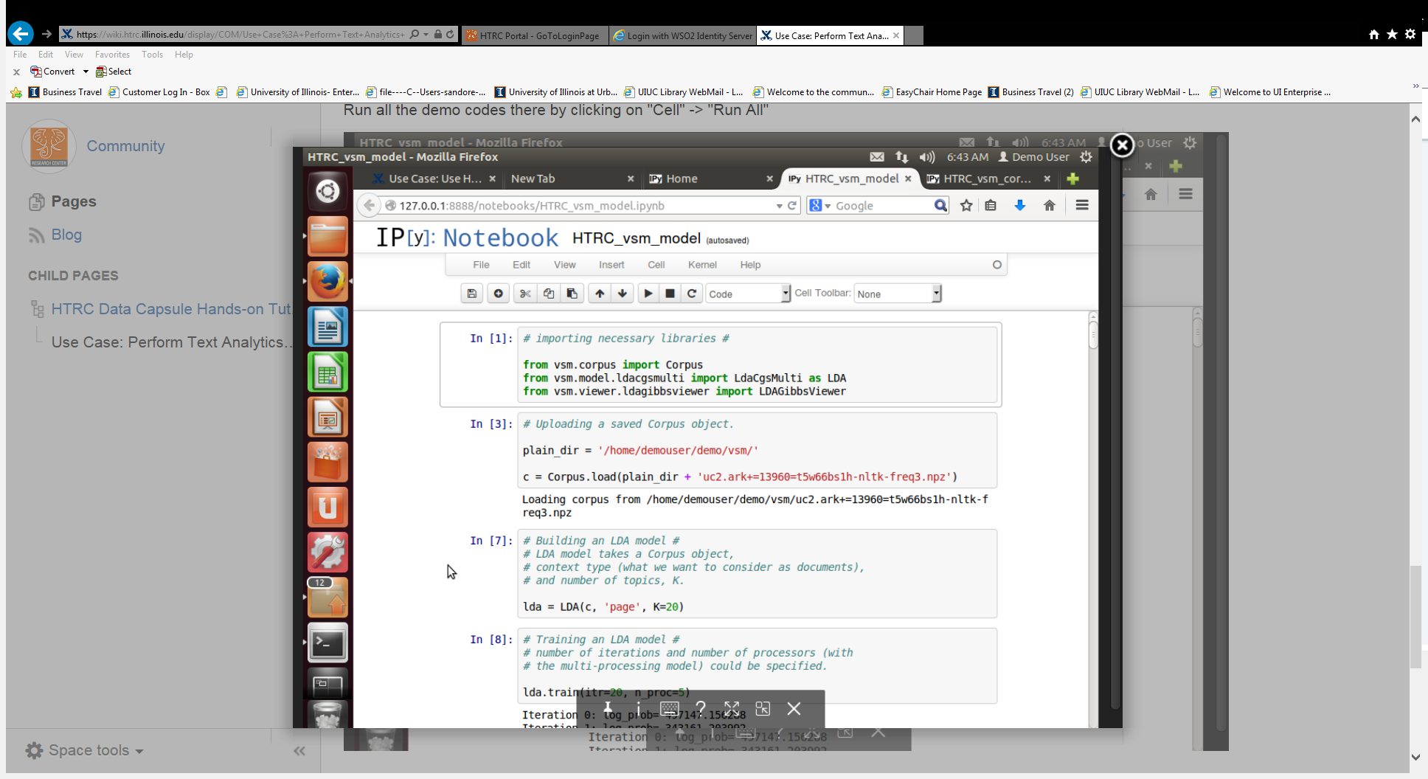
Data Capsule with i-Python installed

Slide 52
Mode switch protection: maintenance mode
HTRC raw data sources
Arbitrary network download allowed
Data Capsule
Data Capsule
User traffic from
desktop allowed
Arbitrary network upload allowed
during maintenance mode, researcher installs new software and loads data into capsule

Slide 53
Mode switch protection: secure mode
HTRC raw data sources
Arbitrary network download not allowed
Arbitrary network upload not allowed
Data Capsule
Data Capsule
User traffic from
desktop allowed
Results : researcher tools must write results to special directory; these are reviewed before release
Researcher switches to secure mode when ready to run her tools

Slide 54
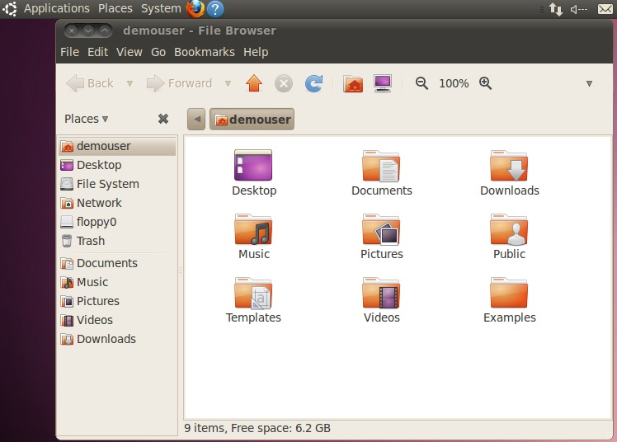
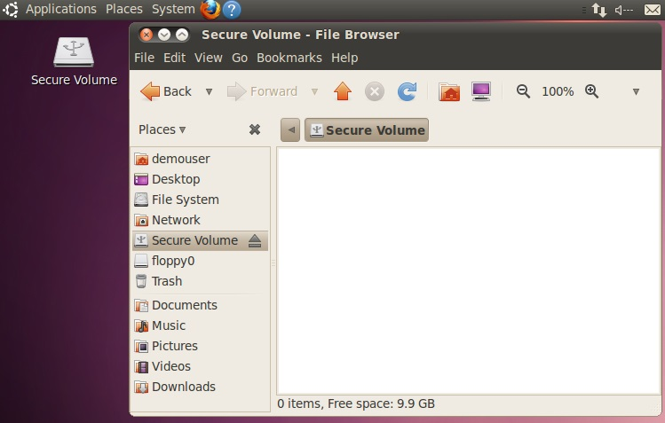
HT Data Capsule Screenshots
Secure Mode
Maintenance Mode

Slide 55
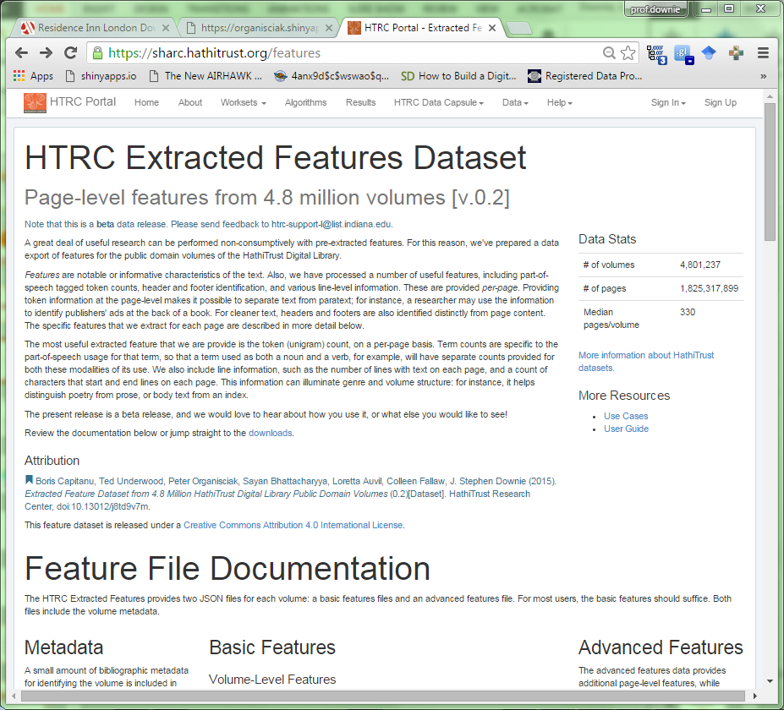
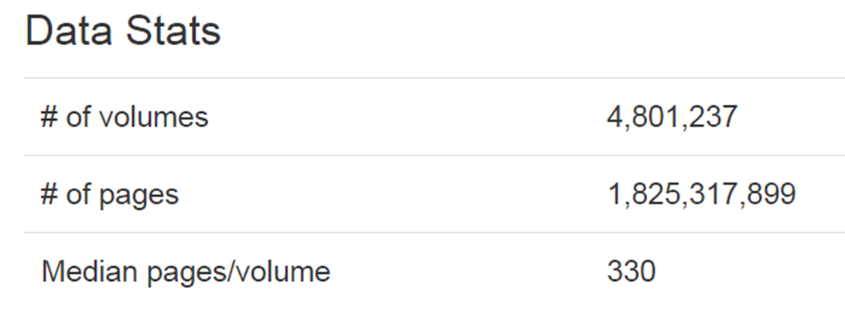
Extracted Features

Slide 56
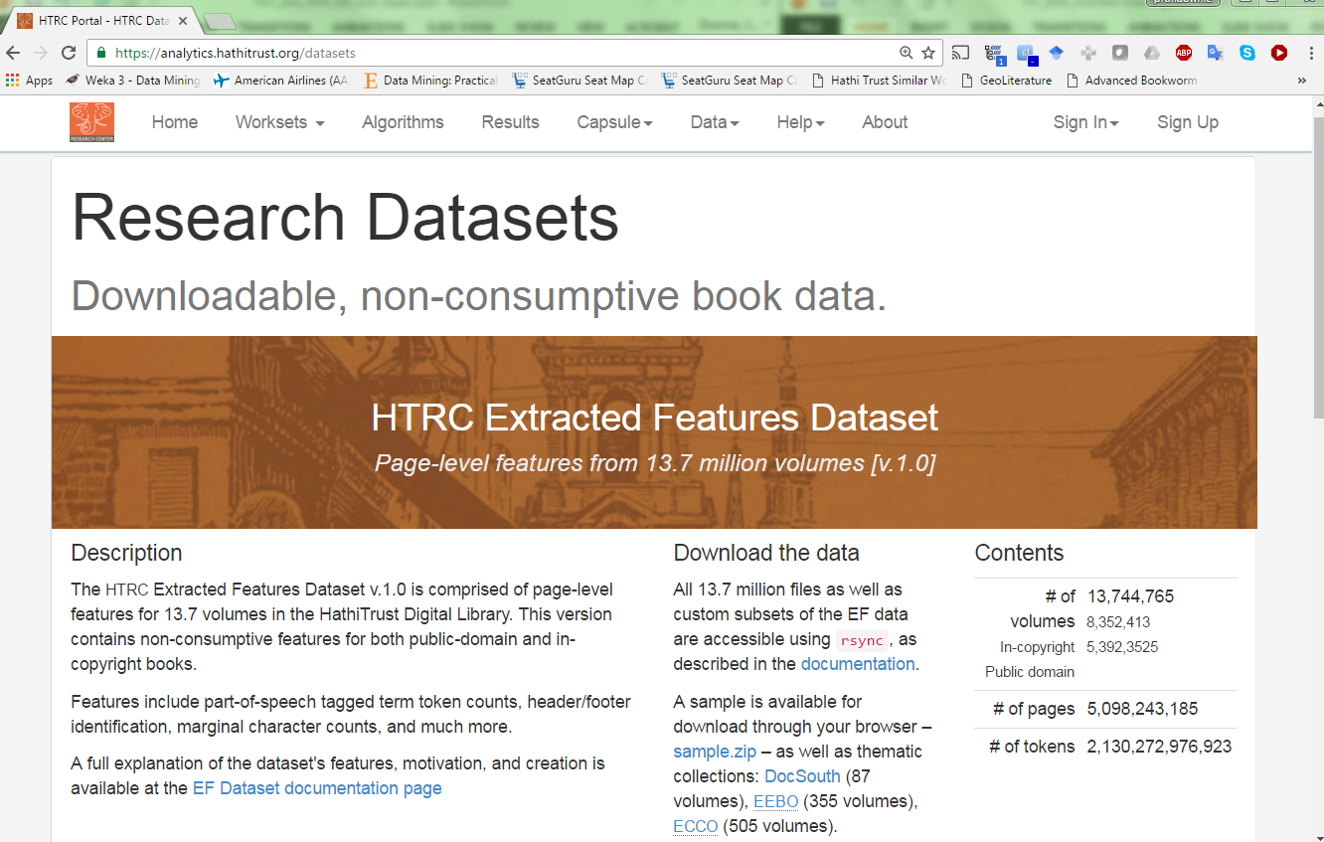
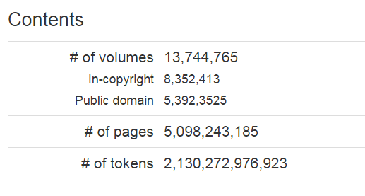
Extracted Features

Slide 57
Extracted Feature Set and Distant Reading
Distant Reading – “…understanding literature not by studying particular texts, but by aggregating and analyzing massive amounts of data.” –
Moretti (Stanford Literary Lab)
https://analytics.hathitrust.org/genre
https://analytics.hathitrust.org/features
HTRC Distant Readers:
Ted Underwood (University of Illinois)
Andrew Goldstone (Rutgers University)
Jonathan Goodwin (University of Louisiana)
Chris Forster (Syracuse University)

Slide 58
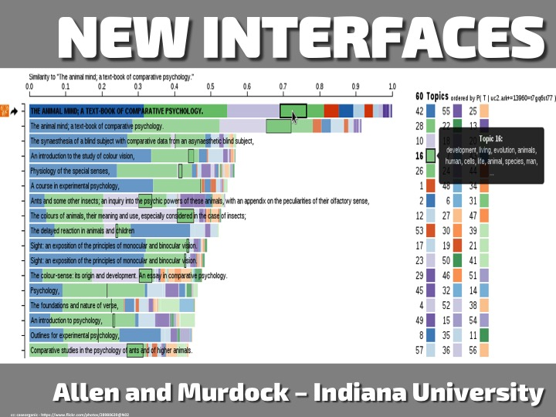

Slide 59
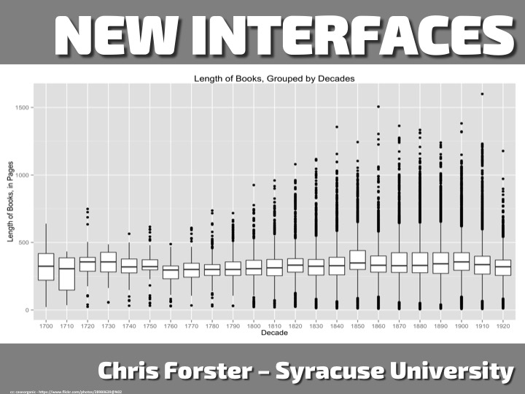

Slide 60
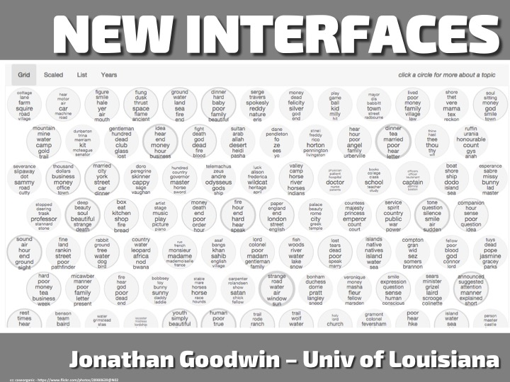

Slide 61
Outreach & Education: Scholarly Commons & Advanced Collaborative Support (ACS)

Slide 62
Scholarly Commons & Outreach Accomplishments (Pt. 1)
User Requirements Studies
Use cases on how researchers would apply text analytics tools and resources in their work.
Results of these studies are informing development of tools and services, training and research support.
Training Module Deployment
In-person and online for the Portal and Workset Builder, Bookworm, and Data Capsule.
Ranges from “beginner” to “advanced”
Training Outcome Assessment
Continuous improvement

Slide 63
Scholarly Commons & Outreach Accomplishments (Pt. 2)
Over 35 presentations or workshops in 7 countries in 6 workshops taught at local and national venues
Conference workshops: HASTAC 2015, the Modern Language Association Annual Convention 2015, and the 2015 Joint Conference on Digital Libraries.
Over 29 talks or lectures presented across a number of disciplines:
Supercomputing 2014, the 2015 Joint Conference on Digital Libraries (papers and a keynote address), and Digital Humanities 2015.
128 people from 24 institutions attended the HT/HTRC UnCamp held March 2015 in Ann Arbor, MI.

Slide 64
Scholarly Commons: Education Development
“Digging Deeper, Reaching Further: Libraries Empowering Users to Mine the HT DL Resources”
IMLS Laura Bush 21st Century Librarian Program
Led by Harriett Green (Illinois) and Angela Courtney (Indiana)
Collaborating institutions:
University of Illinois (CIC-HT)
Indiana University (CIC-HT)
University of North Carolina (Chapel Hill) (HT)
Lafayette College (HT)
Northwestern University (CIC-HT)
Notes:
IMLS Laura Bush 21st Century Librarian grant:
Led by HTRC associate, Harriett Green, and along with librarians at Indiana University, Northwestern University, University of North Carolina at Chapel-Hill, Lafayette College, the HTRC, has just been awarded an Institute for Museum and Library Services Laura Bush 21st Century Librarian grant entitled, “Digging Deeper Reaching Further, Libraries Empowering Users to Mine the HathiTrust Digital Library Resources.” This project, with an award amount of $398,845, runs from October 1, 2015 to September 30, 2018 and is intended to develop a shared curriculum for use in academic libraries including a train-the-trainer series designed to assist librarians in getting started with the tools, services, and related research methodologies of the HTRC.

Slide 65
ACS: Research Projects

Slide 66
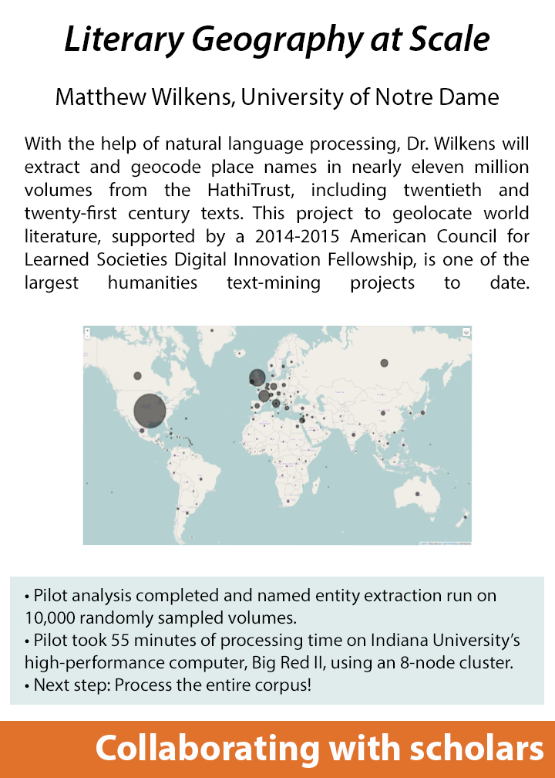
ACS Research Project #1
Notes:
Research questions
Few research questions are relevant over 13.7 million volumes, but when the size of any corpus exceeds about 1,000 volumes, automated ways of searching for the right books become critical.
Early successes are those who learned MARC format
Set up as opportunity for discussion. Metadata comes up here. Improving metadata. Translational contribution.
Read harriet’s grant proposal; Megan structured; teaching : UG to professors

Slide 67
ACS Research Projects #2

Slide 68
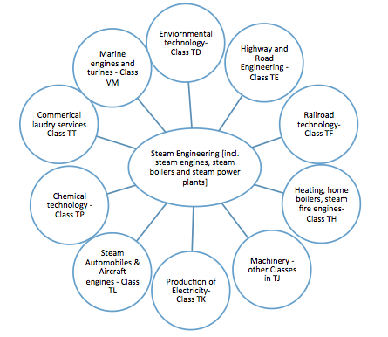
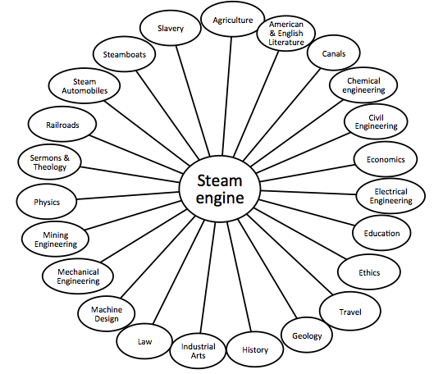
Tracking Technology Diffusion Through Time in the HathiTrust Corpus
Michelle Alexopoulos, University of Toronto
Dr. Alexopoulos, an economist, is using the vast historical record contained in the HathiTrust to study the diffusion of various technologies over time. By tracking word usage trends of 1,214 technology-related terms identified by Alexopoulos, such as the steam engine, her research based on HathiTrust book content has the potential to overturn accepted theories about the economic and societal impacts of a technology.
ACS Research Projects #3
VS.
Linkages to “Steam Engines” implied by the Library of Congress Classification
From HT text: Selected subject terms linked to “Steam engine” n-gram by 1910
1,012,633 volumes analyzed.
Over 22 hours of processing using a 32-node cluster on Indiana University’s high-performance supercomputer, Big Red II.
Each node had 32 cores and 64 GB of RAM.
HTRC Use Case: Collaboration between Scholars and the HTRC

Slide 69
Tracking Technology Diffusion Through Time in the HathiTrust Corpus
Michelle Alexopoulos, University of Toronto
Dr. Alexopoulos, an economist, is using the vast historical record contained in the HathiTrust to study the diffusion of various technologies over time. By tracking word usage trends of 1,214 technology-related terms identified by Alexopoulos, such as the steam engine, her research based on HathiTrust book content has the potential to overturn accepted theories about the economic and societal impacts of a technology.
ACS Research Projects #3
VS.
Linkages to “Steam Engines” implied by the Library of Congress Classification
From HT text: Selected subject terms linked to “Steam engine” n-gram by 1910
1,012,633 volumes analyzed.
Over 22 hours of processing using a 32-node cluster on Indiana University’s high-performance supercomputer, Big Red II.
Each node had 32 cores and 64 GB of RAM.
HTRC Use Case: Collaboration between Scholars and the HTRC

Slide 70
2016 ACS Projects

Slide 71
Fighting Fever in the Caribbean: Medicine and Empire, 1650-1902
Mariola Espinosa, University of Iowa: This project seeks to explore the history of yellow fever in the Caribbean by comparing how the disease was described by residents of the Caribbean to the European perspective, including through sentiment analysis of text referencing yellow fever. Her work will be visualized spatially in a map generated with support from the University of Iowa’s Digital Scholarship and Publishing Studio. She will build a corpus of text from the HathiTrust Digital Library related to yellow fever and filth in the Caribbean to track the use of the terms “filth” and “filthiness” from 1650 to 1902.

Slide 72
Inside the Creativity Boom
Samuel Franklin, Brown University: This project will map the increasing use and shifting meanings of the words “creative” and “creativity,” with a particular focus on the twentieth century. A custom “creativity corpus” will be assembled and processed to identify linguistic patterns via a number of text analysis and natural language processing techniques. Brown’s project will make use of the functionality developed for HathiTrust + Bookworm.

Slide 73
The Chicago School: Wikification as the First Step in Text Mining in Architectural History
Dan Baciu, Illinois Institute of Technology: This project will look at the Chicago School of architecture and examine its history of reception over the last 75 years, as well as identify patterns in its international spread and influence. Baciu will use named entity recognition in his analysis, notably deploying the Wikifier tool on a large sample corpus of HathiTrust data for the first time.

Slide 74
Signal and Noise and Pride and Prejudice: Toward an Information History of Romantic Fiction
Dallas Liddle, Augsburg College: This project will test two hypotheses about information theory and information density as they relate to a digital humanities approach to studying Romantic-era British fiction. The concept of "information" used in mathematical information theory may help digital humanists evaluate the information density of textual forms. This project tests a theory that the popular and critical success of the novel in British print culture after 1815 may be related to increased information density and sophistication of information encoding in those years, especially via innovations introduced by Jane Austen and Walter Scott.

Slide 75
HTRC Research Projects

Slide 76
Recent and Current U.S. Grants
Data Capsule
Alfred P. Sloan Foundation
Workset Creation for Scholarly Analysis + Data Capsules
Andrew W. Mellon Foundation
Exploring the Billions and Billions of Words in the HathiTrust Corpus with Bookworm
National Endowment for the Humanities

Slide 77
Workset Creation for Scholarly Analysis: Prototyping Project
Collection analysis and prototype tools & services to facilitate workset creation
J. Stephen Downie, Tim Cole, Beth Plale
Andrew W. Mellon Foundation
1 July 2013 - 30 June 2015
Evolved to WCSA+DC
1 January 2016 – 31 December 2017
Proposal Narrative:
http://bit.ly/htrrcworksetgrant

Slide 78
Grand Motivation
The ability to slice through a massive corpus constructed from many different library collections, and out of that to construct the precise workset required for a particular scholarly investigation, is an example of the “game changing” potential of the HathiTrust...

Slide 79
Two Project Streams
Workset formal structures and semantics
Work in conjunction with Center for Informatics Research in Science and Scholarship at the Graduate School of Library and Information Science
WCSA I Prototyping Projects
Four projects funded by the grant but conducted by community teams

Slide 80
What is Workset? #1
A workset is an aggregation of materials brought together for the purpose of analysis.

Slide 81
What is a Workset? #2
Worksets are conceptual and must be expressible in a variety of ways
Need to allow creation outside of HathiTrust
Need to facilitate inclusion of resources beyond HathiTrust
Need to facilitate the inclusion of resources at many different levels of granularity beyond the book

Slide 82
What is Workset #3
Worksets encapsulate the specific materials that underwent analysis.
Need to capture provenance information
Possible recording of parameters

Slide 83
What is a Workset? #4
Worksets should be able to spawn descendants but otherwise immutable

Slide 84
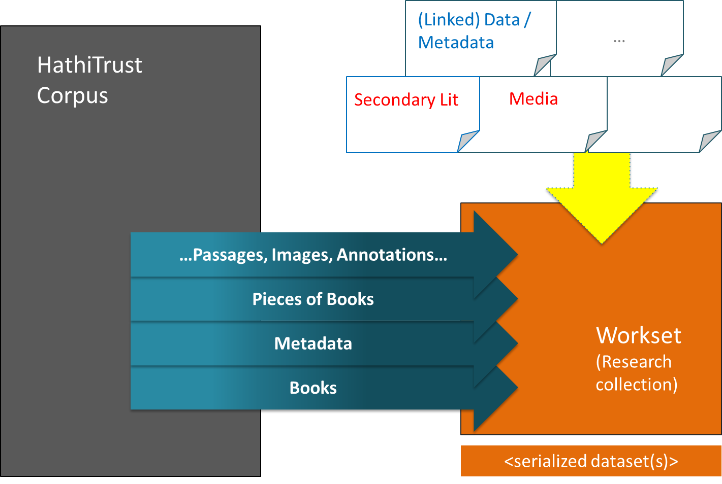
Scope

Slide 85
Exploring the Billions and Billions of Words in the HathiTrust Corpus with Bookworm
National Endowment for the Humanities Implementation Grant
Team
J. Stephen Downie, University of Illinois at Urbana-Champaign
Erez Lieberman Aiden, Baylor College of Medicine
Benjamin Schmidt, Northeastern University
Robert McDonald, Indiana University
Loretta Auvil, University of Illinois at Urbana-Champaign
Sayan Bhattacharyya, University of Illinois at Urbana-Champaign
Colleen Fallaw, University of Illinois at Urbana-Champaign
Muhammad Shamim, Baylor College of Medicine
Peter Organisciak, University of Illinois at Urbana-Champaign

Slide 86
Exploring the Billions and Billions of Words in the HathiTrust Corpus with Bookworm (HT+BW)
National Endowment for the Humanities Implementation Grant
Team
J. Stephen Downie, University of Illinois at Urbana-Champaign
Erez Lieberman Aiden, Baylor College of Medicine
Benjamin Schmidt, Northeastern University
Robert McDonald, Indiana University
Loretta Auvil, University of Illinois at Urbana-Champaign
Sayan Bhattacharyya, University of Illinois at Urbana-Champaign
Colleen Fallaw, University of Illinois at Urbana-Champaign
Muhammad Shamim, Baylor College of Medicine
Peter Organisciak, University of Illinois at Urbana-Champaign

Slide 87
Principal goals for the HT+BW Project
To integrate Bookworm into HTRC in ways that are beneficial to our core demographic of humanities researchers; and,
To develop our improvements to Bookworm in ways that can be contributed back to the open source project and benefit other large-scale textual repositories.

Slide 88
HT+BW Project
HT
Textual data
Metadata
BW
Tool that visualizes language usage trends in repositories of digitized texts in a simple and powerful way
Data engine
API (for multiple interfaces/visualizations)

Slide 89
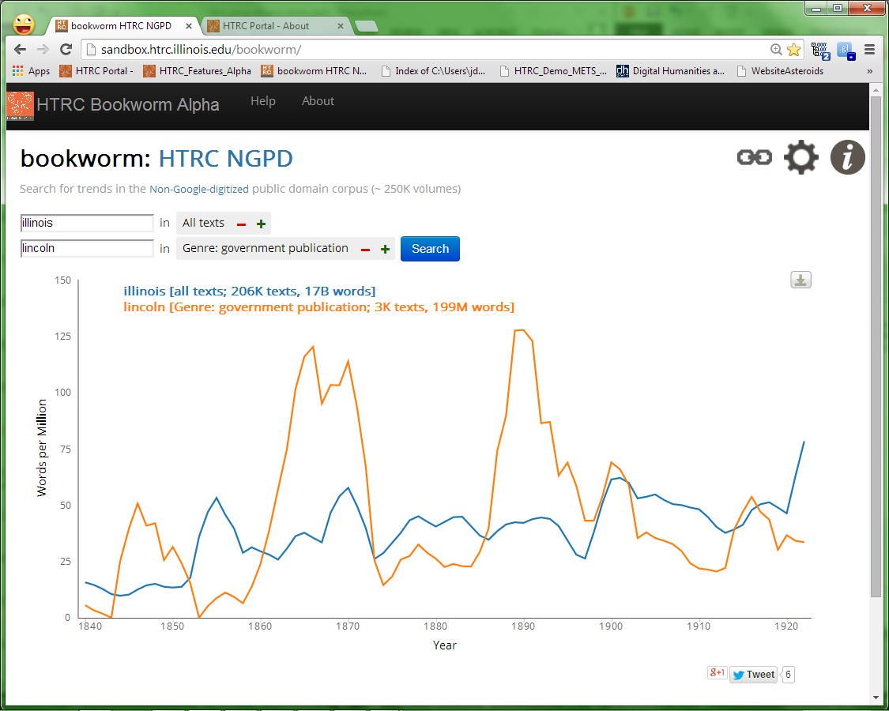
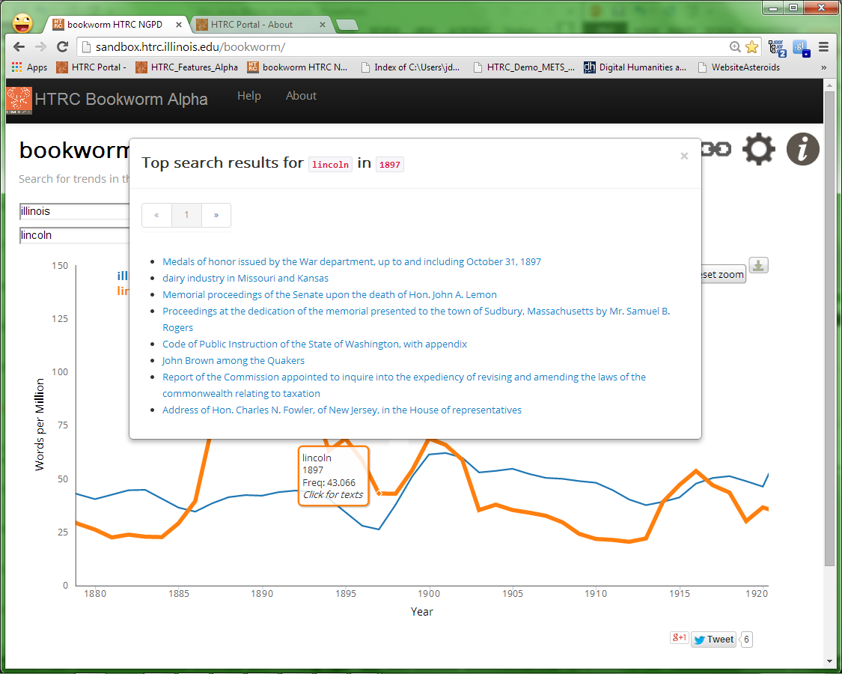

Slide 90
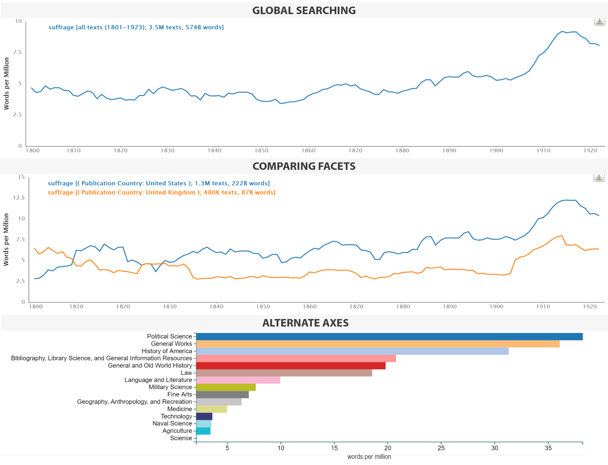

Slide 91
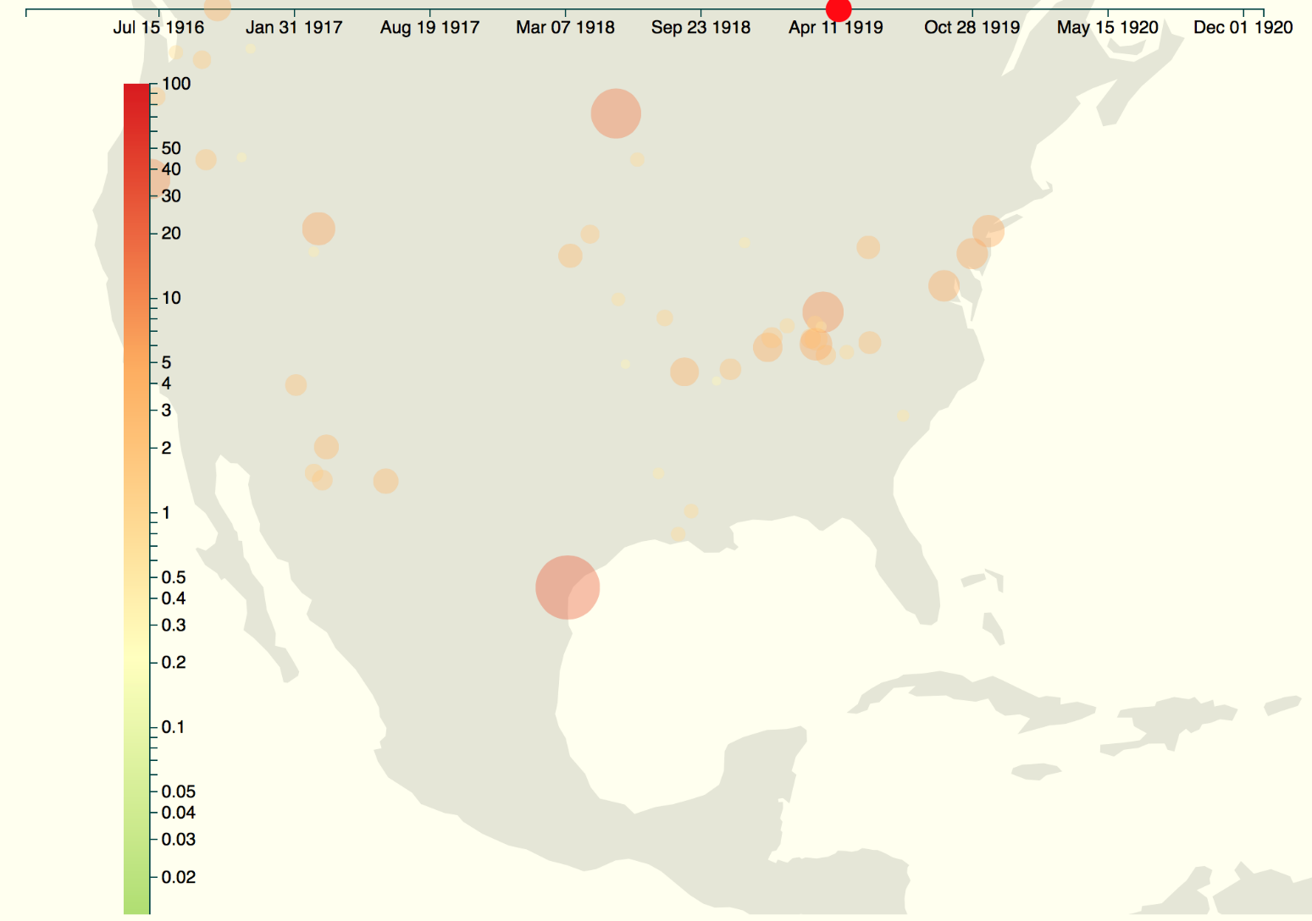
Using Maps
Leveraging metadata viz tools

Slide 92
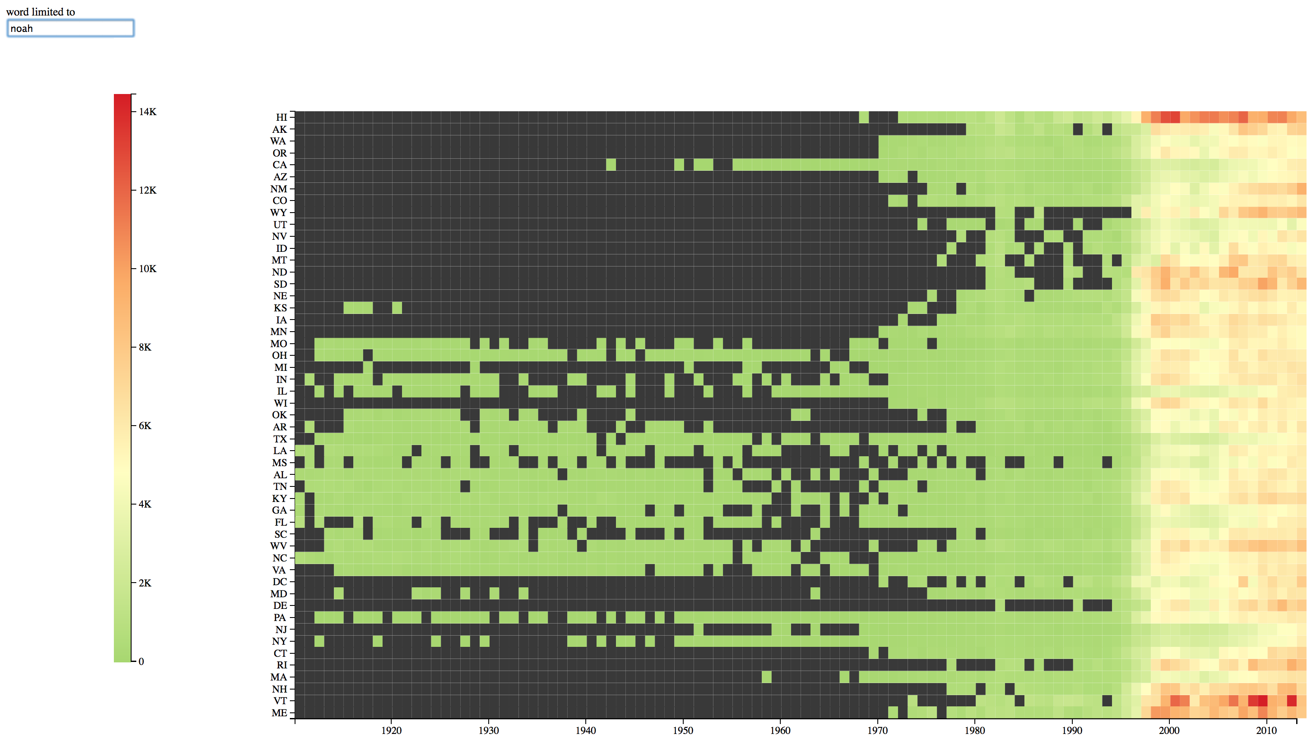
Using Heatmaps
Metadata serves as attributes for heatmaps
2013 top boy name,“noah”, displayed over time by US State

Slide 93
Canadian Collaborations
Novel TM
PI: Andrew Piper, McGill University
http://novel-tm.ca/
The Single Interface for Music Score Searching and Analysis Project (SIMSSA)
PI: Ichiro Fujinaga, McGill University
http://simssa.ca/

Slide 94
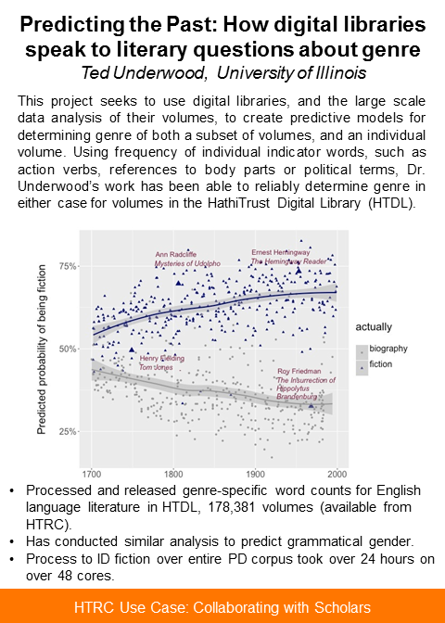
Sample NovelTM Project

Slide 95
Jumping to Demos
Bookworm
Extracted Features

Slide 96
Wrap Up

Slide 97
HTRC Future Work
Release of new Extracted Features dataset
Release of next generation HTRC Bookworm
Advanced Collaborative Support
Special call for scholars using copyrighted materials in conjunction with Data Capsules
Rebuild of Workset Builder
Mix of SOLR and LOD
Revisit portal design
Translational research (Bookworm?)

Slide 98
Personal Goals for HTRC
Keep up momentum on workset and builder research
Engage in more collaborative projects
Expand to have more truly international partnerships
Need to explore and work with Asian materials
Make sure to move beyond text
Explore accessibility issues for visually impaired

Slide 99
Thank You!

